Slide 1
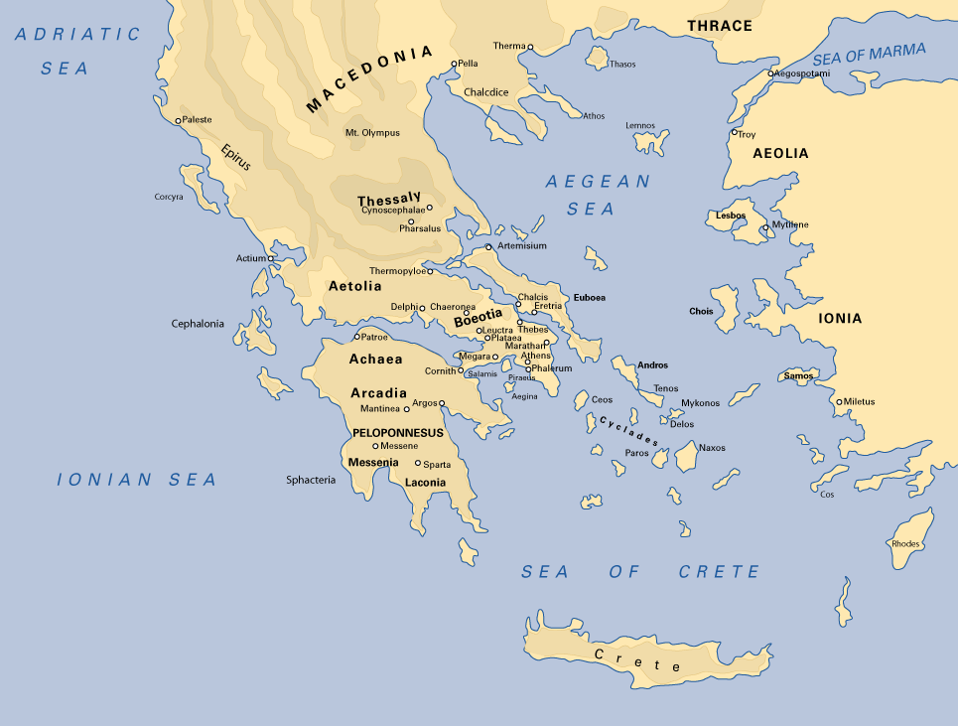
Greece – Tutor to the World
Gautam Biswas
JC Bose National Fellow and Director
Indian Institute of Technology Guwahati
Guwahati – 781039, india

Slide 2
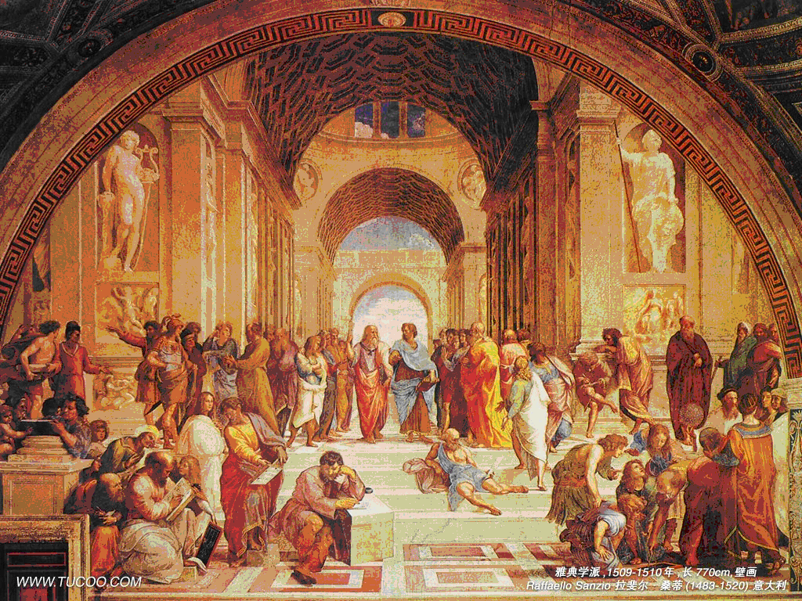
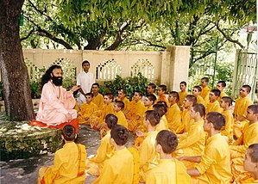
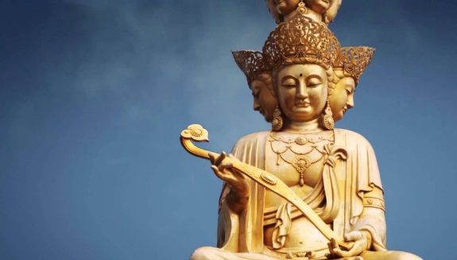
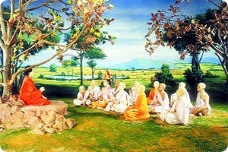
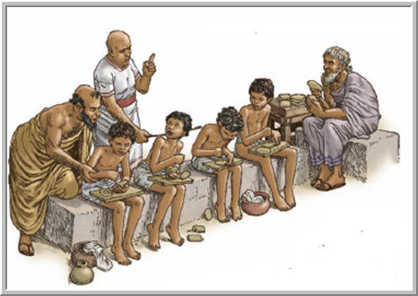
Five ancient civilizations
The ancient civilizations (Babylon, India, China, Greek Maya) knew many mathematical results, they were strong in science, they worked on human values….
School of Athens
Gurukul of India
School at Mesopotamia
School in China

Slide 3
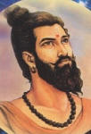
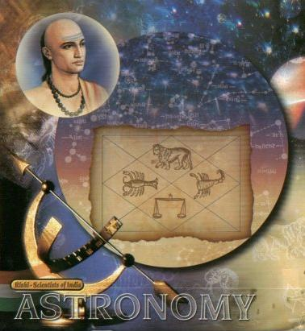
Maharshi Kanad (600 BC)
The first known conception of the atomistic approach to the material world is perhaps found in the works of Maharshi Kanad (600 BC), who developed the Vaisesika philosophy. In this philosophy, the atomistic model of the material world is propounded. However the Vaisesika philosophy goes well beyond the material world and it seeks to explore the cognizable material universe in terms of nine elements: air, earth, fire, mind, self, sky, space, time and water. Maharshi Kanad’s contributions to scientific analysis of the universe are extensive.
Varahamihir (499-587 BCE) – Eminent Astrologer and Astronomer: Varahamihir’ s book “panchsiddhant” holds a prominent place in the realm of astronomy. He noted that the moon and planets are lustrous not because of their own light but due to sunlight.

Slide 4
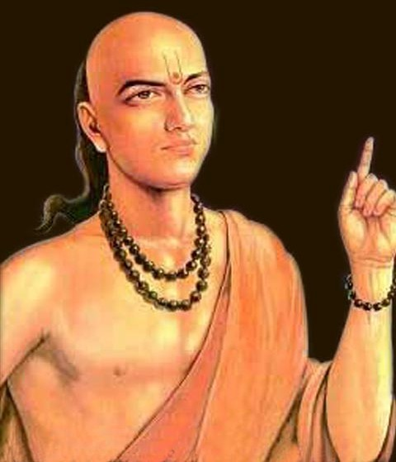
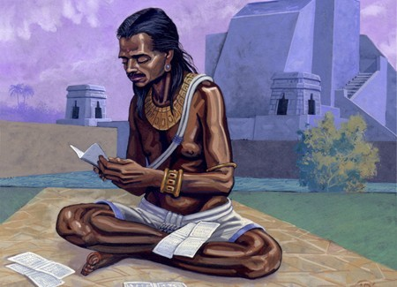
Aryabhatta (476-550 A.D.)
One of the world’s greatest mathematician-astronomer, was born in Patliputra in Magadha (now Patna in Bihar)
Wrote his famous treatise the "Aryabhatta-siddhanta" but more famously the "Aryabhatiya".
Became immortal for his greatest discovery of ‘ZERO’.
Aryabhatta was an author of at least three astronomical texts and wrote some free stanzas as well. He calculated 3.1416 close to the actual value Pi (3.14159).
ZERO: The Indian scholar PINGALA (circa 5th-2nd century BC) first attempted to define zero
In 498 AD, ARYABHATTA stated that "sthānāt sthānaṁ daśaguņaṁ syāt" (literally, "place to place in ten times in value"), i.e. "from place to place each is ten times the preceding" which is the origin of the modern decimal-based place value notation.
BRAHMAGUPTA (attempt to divide with zero, discovery of negative numbers, 598-668 AD)
Glimpses of Indian
Civilization

Slide 5
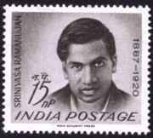
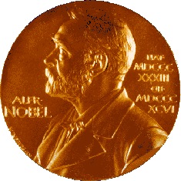
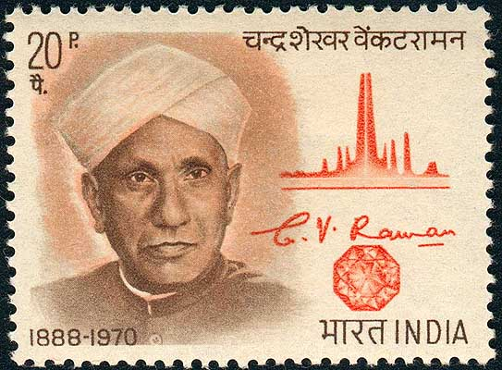
Recognitions in early stage of Modern Era of Science
1841 - 1950 : 12 Indians were elected Fellow of the Royal Society of London.
A. Cursetjee, Engineer & Shipbuilder
S. Ramanujan, Mathematician
Sir J. C. Bose, Bio-physicist
Sir C. V. Raman, Physicist
Meghnad Saha, Physicist
Birbal Sahni, Palaeo-botanist
Sir K. S. Krishnan, Physicist
Homi J. Bhabha, Physicist
Sir S. S. Bhatnagar, Chemist
S. Chandrasekhar, Astrophysicist
P. C. Mahalanobis, Statistician
D.N. Wadia, Geologist

Slide 6
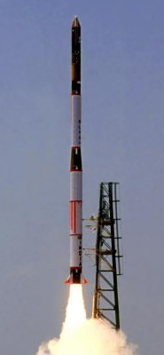
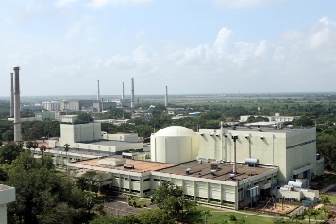
Therefore, if one extrapolates to today, it should not come as a surprise that India’s technological prowess grew from good foundations

Slide 7
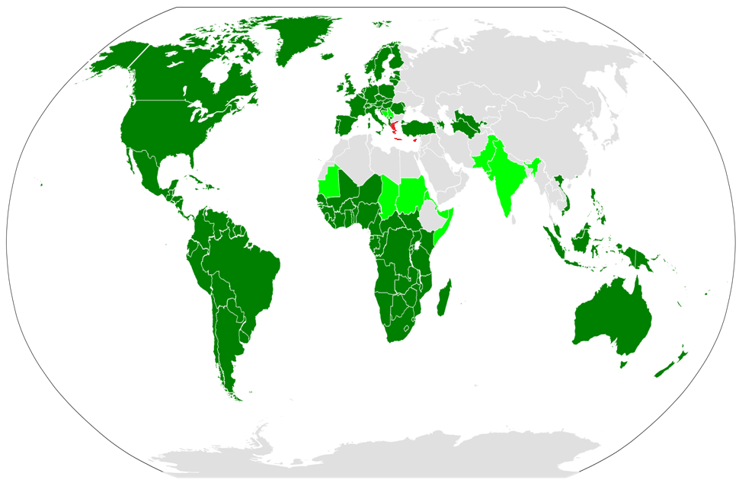
The Latin alphabet is in widespread use across the world
The Greek alphabet is used only in a tiny region
a b c d e f g h I j k l m n o p q r s t u v w x y z
α β γ δ ε ζ η θ ι κ λ μ ν ο ξ π ρ σ τ υ φ χ ψ ω
Yet everyone who has studied science or technology in the whole world is very familiar with the Greek alphabet…
This seemingly trivial fact indicates the enormous influence of Greek pioneering ideas on modern scientific thought.

Slide 8
Every branch of scientific advancement takes Greek ideas and Greek terminology for granted, often without even realizing the enormous debt we owe to the ancient Greek scientists and philosophers.
Even today, many of the questions asked by the ancient Greek philosophers in a wide variety of fields, are still being asked, and we are still seeking the answers…
Some of these ideas will be highlighted in this brief address.

Slide 9
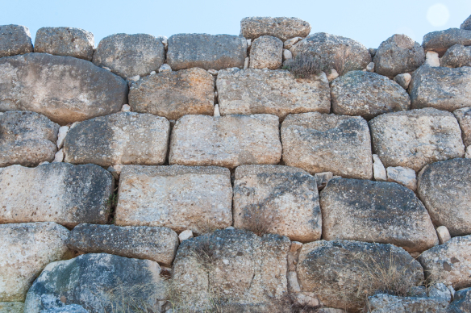
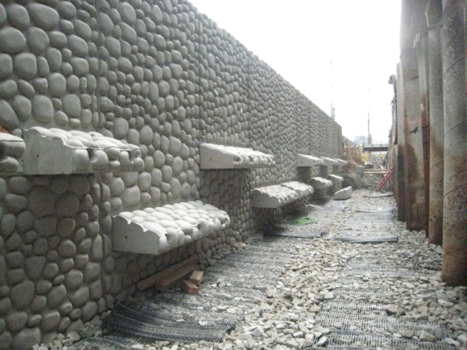
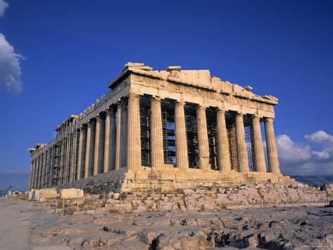
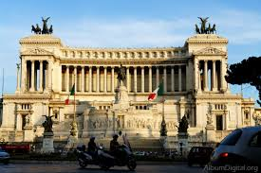
Architecture and Construction
The largest objects existing in the modern world which betray Greek influence are buildings…
Mycenae, 14th c. BCE Seattle sea wall, 2017
Parthenon, 5th c. BCE Victor Emmanuel Memorial, 19th c. CE

Slide 10
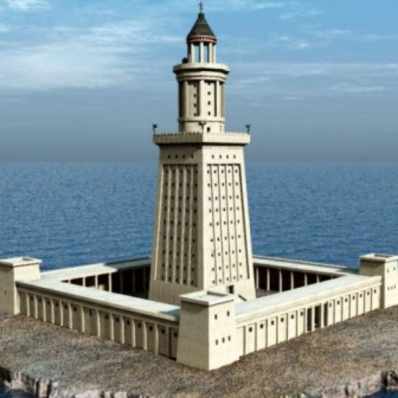
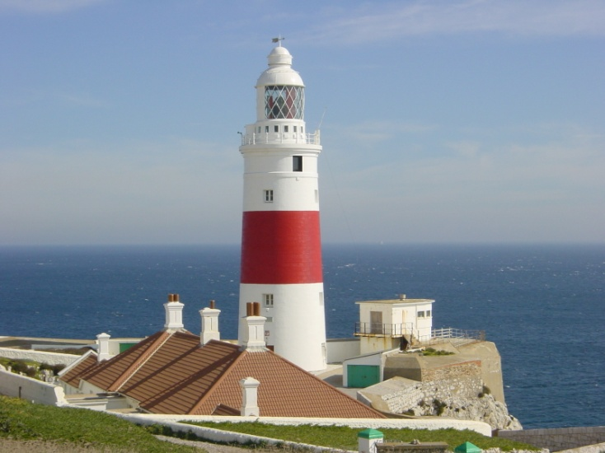
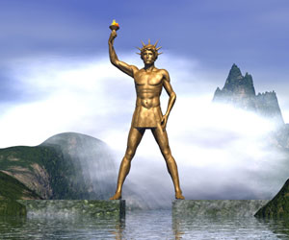
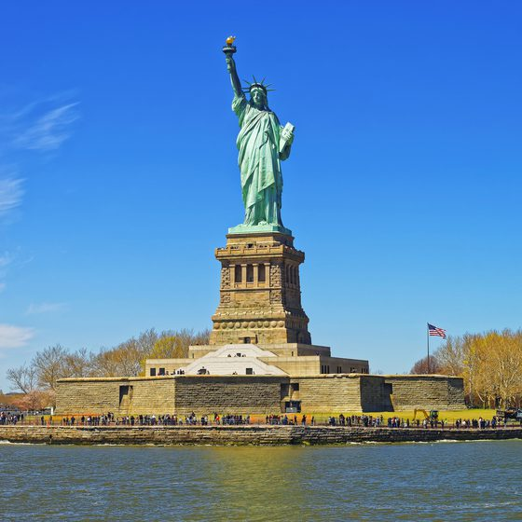
Pharos, c. 260 BCE Gibraltar Lighthouse, 1841 CE
Colossus of Rhodes, 280 BCE Statue of Liberty, 1886 CE

Slide 11
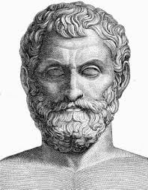
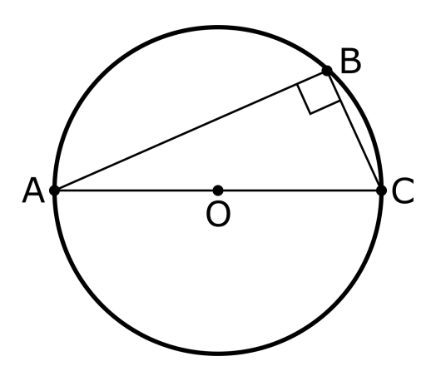
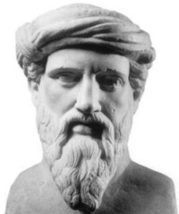
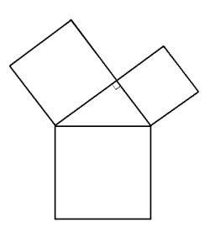
Mathematics
Other ancient cultures (Babylon, India, China, Maya) knew many mathematical results, but it is to Greece that we owe the stress on logical proofs…
Thales of Miletus (c. 624 – c. 546 BCE) is believed to have provided the first deductive proof of what we call Thales’ theorem. It is
still used by masons to quickly make right angles.
To Pythagoras of Samos (c. 569 – c. 475 BCE) we owe the first proof of what we know as Pythagoras’ theorem. This theorem is the cornerstone of all of coordinate geometry, mechanics and linear algebra.

Slide 12
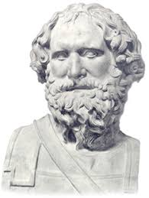
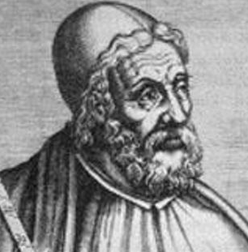
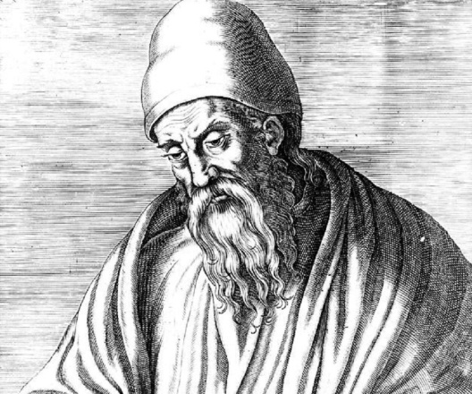
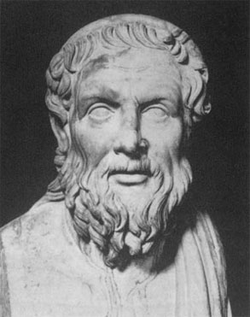
Archimedes of Syracuse (c. 287 – c. 212 BCE) carried out integration long before the invention of calculus and determined that the value of π lies between ²²/₇ and ²²³/₇₁.
The organisation of mathematical proofs as axioms, theorems, lemmas and corollaries was set up by Eudoxus of Cnidos (390 – 337 BCE). We still follow it.
Euclides of Alexandria (c. 340 – c. 270 BCE) – famous as Euclid – wrote his famous geometrical treatise called The Elements, which remained the standard textbook for schools till very recent times.
To Apollonius of Perga (fl. 300 BCE) we owe the theory of conic sections – circles, parabolas, hyperbolas, etc., without which spacecraft could not be directed.

Slide 13
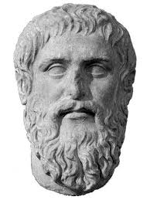
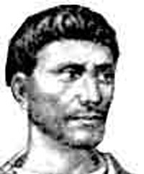
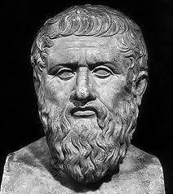
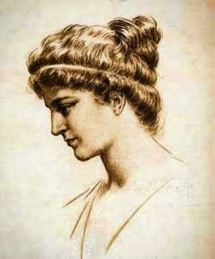
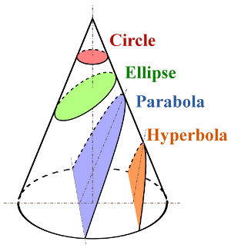
Platon the Athenian (c.428 - 347 BCE) – the great Plato – discovered the ‘regular’ solids and stressed the importance of symmetry, which is a cornerstone of modern physics.
Diophantus of Alexandria (c. 201 - 285 CE) wrote the Arithmetica, the first treatise on algebra. Diophantine equations, i.e. algebraic equations involving integers only, are still being researched by modern number theorists.
Pappus of Alexandria (c. 290 - 350 CE) was the father of solid geometry. His theorems on centroids of revolution are still very useful in mechanics.
Hypatia of Alexandria (c. 360 - 415 CE) pioneered
math education in schools. Her assassination
brought an abrupt end to ancient Hellenistic
mathematics.

Slide 14
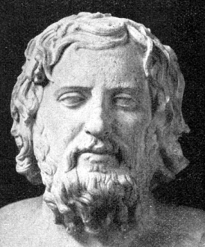
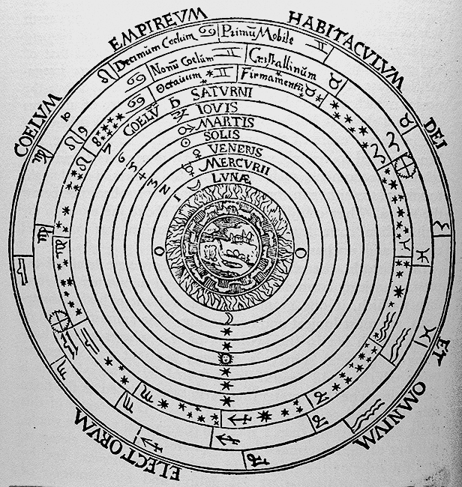
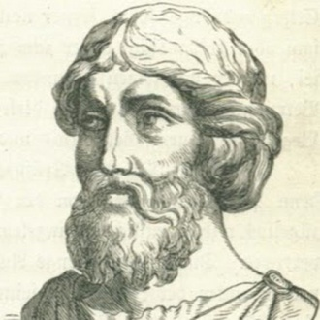
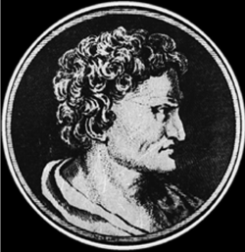
Astronomy
Anaxagoras of Clazomenae (c. 510 – c. 428 BCE), friend of Pericles, declared that the Sun and stars are not gods but just fiery stones, like meteors. He is the first known scientist to face religious persecution for his views.
Eudoxus of Cnidos (390 – 337 BCE), inspired by Plato, set up the geocentric model of the Universe, with concentric crystal spheres.
Our model of the solar system today is similar.
Aristarchus of Samos (c. 312 – c. 230 BCE), realised that the Sun and not the Earth was at the centre of the planetary spheres
– a heliocentric theory 18 centuries before Copernicus.
Hipparchus of Nicaea (c. 190 – c. 120 BCE), discovered the precession of the equinoxes. He measured the Earth-Sun and Earth-Moon distances as 71 – 81 and 67 – 72 Earth radii respectively (the correct value are 25,000 and 64). He also prepared the first star chart.

Slide 15
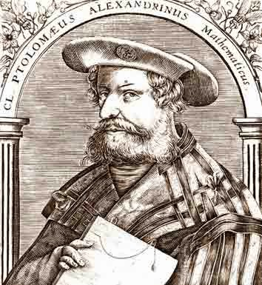
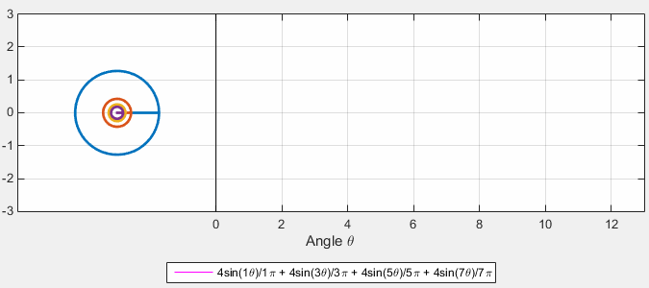
To Claudius Ptolemy of Alexandria (c. 100– c. 170 CE), we owe a complete (though geocentric) picture of the planetary motions, using the idea of epicycles which are today known as the Fourier series.
For 800 years, till Kepler, Ptolemy’s Almagest remained the standard textbook for all positional astronomy.

Slide 16
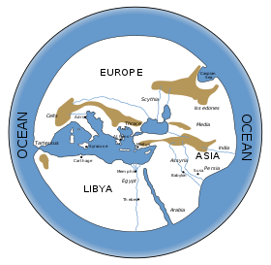
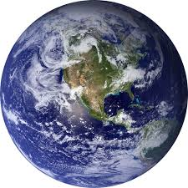
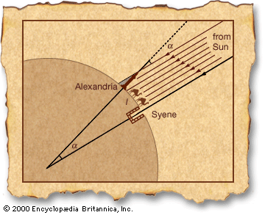
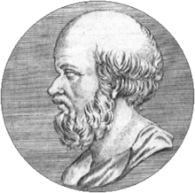
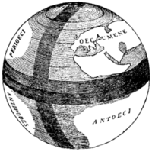
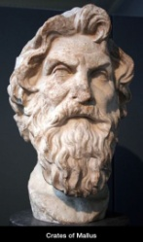
Geography
Hecataeus of Miletus(c. 550 – c. 476 BCE), was the first to introduce the notion of a scale in drawing maps…
It was Pythagoras who first declared that the Earth is a sphere…
…though his Earth was static…
Eratosthenes of Cyrene (c. 276 – c. 195 BCE), founded geodesy by comparing the latitude of Alex-andria and Syrene (Aswan) estimated the circumference of the Earth to be 252,000 stadia or around 46,620 km. The correct figure is about 39,000 km.
Crates of Mallus (fl. 2nd c. BCE), made the first globe and declared that there are 4 continents.
Strabo and Ptolemy wrote extensively in the field of descriptive geography.

Slide 17
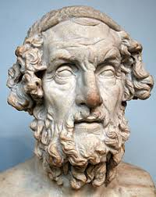
Meteorology
Homer (c. 7th c. BCE ?), the great epic poet, has a fanciful description of the four winds in the Odyessy, showing keen observation of the climate and its trends.
Hesiod (c. 7th c. BCE ?), the other great ancient poet, in his Works and Days, gives advice to farmers and seamen, based on detailed observations of climate and weather, with accurate dates and times. Perhaps the first almanac.
Aristotle of Stageira (384 – 322 BCE) – the greatest mind of antiquity – wrote a book called the Meteorology, creating the subject and trying to give scientific explanations for weather. He can be said to have founded the science.
The Tower of the Winds at Athens, built in 50 BCE, was the first meteorological observation station.

Slide 18
Atomism
The basic substance out of which everything is made is
Thales of Miletus
Air
Heraclitus of Ephesus
Earth
Fire
Parmenides of Elea
Water
Anaximenes of Miletus
Empedocles of Acragas
Doctrine of four elements
Still survives as 4 phases of matter: liquid, gas, plasma, solid

Slide 19
Democritus of Abdera (c. 460 – c. 370 BCE), declared that the basic objects which build the world are atoms. His ideas were rejected by Aristotle but revived by John Dalton in 1808.
“Nothing exists except atoms and empty space; everything else is opinion.”
- Democritus
Photo of tungsten atoms taken by a scanning electron microscope (2015)

Slide 20
Zoology
Anaximander of Miletus (c. 610 – 546 BCE), studied fossils and concluded – correctly – that life originated in the seas. He had some rudimentary ideas about evolution.
Aristotle, among his other achievements, created the science of zoology almost single-handed. He created the first zoo in the gardens of his school, the Lyceum. Alexander the Great was one of the major suppliers of exotic animals to this zoo.
Aristotle classified at least 540 different species and dissected 50 or more of them.
Herophilus of Chalcedon (c. 335 – 280 BCE) and Erasistratus of Chios (c. 304 – c. 250 BCE) continued the practice of dissection, and may have been the first to dissect humans.

Slide 21
Botany
"We must consider the distinctive characters and the general nature of plants from the point of view of their morphology, their behaviour under external conditions, their mode of generation and the whole course of their life.“
– Theophrastus of Eressus (c. 371 – 287 BCE),
known as the father of botany.
Dioscorides of Anazarbus (c. 40 – 90 CE), composed the first Materia Medica, a compendium of medicinal plants and herbs. He is known as the father of pharmacology.
Mithridates IV of Pontus (135– 63 BCE), was a
specialist in poisons and antidotes. He immunized himself to so many poisons that when he wanted to commit suicide, no poison worked, and he had to be killed with a sword.

Slide 22
Medicine
Hippocrates of Cos (c. 460 – c. 370 BCE) is universally acknowledged as the father of medicine. He was the first to declare that diseases are caused by natural causes (and not by magic or the curse of the gods) and hence can be treated by natural methods – diet, rest, drugs. His basic clinical procedures are still followed in modern hospitals.
Hippocratic Oath : “I swear… I will use treatment to help the sick according to my ability and judgment, but never with a view to injury and wrong-doing… whatsoever I shall see or hear in the course of my profession, …if it be what should not be published abroad, I will never divulge, holding such things to be holy secrets…”
Hippocratic maxim : First, do no harm ⎯ followed by all doctors.

Slide 23
Galenus of Pergamon (129 – 216CE) – known as Galen – produced the first sketches of human anatomy. He built up a theory of four bodily fluids, or ‘humours’ – blood, black bile, yellow bile and phlegm in the first attempts to understand human physiology. He knew that it was blood which circulated in the arteries and veins, and that the heart is just a pump for the blood.
The concept of four humours is still central to much of alternative medicine.
Aristotle took the first steps towards psychoanalysis. His book On the Soul, discusses human thought and feelings and proposes that madness is a disease and not a curse of the gods.
Artemidorus of Daldis (fl. 2nd c. BCE) wrote a book called The Interpretation of Dreams. Much of his work is fanciful, but he did identify many of the root psychological causes of dreams. When Sigmund Freud began to write on psychoanalysis, his first book was called The Interpretation of Dreams – in honour of the ancient Greek savant.

Slide 24
Genetics
Hippocrates believed in the direct inheritance e of traits from parents. He made detailed records and thought that every part of the parents’ bodies make contributions to the bodies of the offspring.
Aristotle criticized Hippocrates, pointing out that hair and nails are dead tissue, but they were also inherited.
He also discovered what are now called ‘recessive’ characters by quoting the following case:
A Greek man married an Ethiopian woman and all their
children looked like Greeks. But when these children married and had their own children, some of them showed the Ethiopian character again. Where was it hidden in the middle generation?

Slide 25
Technology
Archimedes discovered the law of the lever in the 3rd c. BCE.
“Give me a place to stand on, and I will move the Earth” - Archimedes
He put this knowledge to good use in the Archimedes screw and in the many military engines he used in the defense of Syracuse against the Romans in 213 BCE.
These included a huge lever
called the Claw of Archimedes, which could catch a
Ship and up-end it, so that it sank.
Archimedes’ Principle is the cornerstone of hydrostatics. The word used by him – Eureka!, i.e. I have found it – has become the standard word to describe scientific discovery…

Slide 26
Heron of Alexandria (c. 10 – c. 70 CE) – known as Hero – invented the aelopile, a basic steam engine operating on the turbine principle.
He designed the dioptra – a machine for surveying which is essentially the theodolite.
He also invented a coin-operated vending machine which is the ancestor of the modern device one sees everywhere.
The Antikythera Mechanism, retrieved from a shipwreck which occurred around 70 BCE, was a highly sophisticated mechanical analog computer which calculated the positions of the Sun, Moon and stars and predicted eclipses using complicated gears. It may have been made around 200 – 150 BCE, probably in Rhodes.
All this proves that the ancient Greeks were as clever with their hands as with their minds.

Slide 27
Ancient Greeks contributed to many other fields, such as logic, literature and literary criticism, political thought, metaphysics, ethics, and all branches of science.
The very word ‘philosophy’ is a Greek word, and the first creed of the philosopher and the scientist comes from the timeless teachings of Socrates…
“True wisdom comes to each of us when we realize how little we understand about life, about ourselves and the world around us.” – Socrates
Thank You

